Slide 1

Simple statistics
Data Visualisation

Slide 2
Overview
Quantitative relationships
Relationships found within Categories
Hierarchical Relationships
Relationships between quantities
Numbers that Summarize
Measures of Variation

Slide 3
Quantitative Relationships
Choosing a table or graph depends on what story you are trying to tell
Quantitative are always about relationships.
Here are some common examples of relationships that define the essential nature of the quantitative stories
Quantitative Information | Relationship
Units of product sold per geographical region | Sales related to geography
Revenue by quarter | Revenue related to time
Expenses by department and month | Expenses related to organizational structure and time
A company's market share compared to that of its competitors | Market share related to companies
The number of employees who received each of the five possible performance ratings (1-5) during the last annual performance review | Employee counts related to performance ratings

Slide 4
Quantitative Relationships
Quantitative stories – feature two types of data
  Quantitative – measure things - values
  Categorical – divide information into groups
  Items that make up a category are measured
Simple associations
  Quantitative value and corresponding category
Complex associations
  Multiple sets of Quantitative values
  E.g. Number of emails sent in relation to an order
  E.g. Number of emails sent in relation to book and magazine (broken down) orders over the last year in comparison to our competitors

Slide 5
Relationships found within Categories
Nominal
Ordinal
Interval
discrete items that belong to a single category but really don’t relate to one another in any particular way. They differ in name only (that is, nominally), have no particular order and don’t represent quantitative values.
consist of items that, unlike the items in a nominal scale, do have an intrinsic order but in and of themselves still do not correspond to quantitative values.
like ordinal scales, consist of items that have an intrinsic order, but they also represent quantitative values. An interval scale starts out as a quantitative scale that is then converted into a categorical scale by subdividing the range of values in the entire scale into a sequential series of smaller ranges of equal size; each range is given a label.

Slide 6
Relationships found within Categories
Question
Here’s a quick test to see how well you’ve grasped these concepts.
Can you identify the type of categorical scale that appears in the example below?
Answer
Months of the year obviously have an intrinsic order, which raises the question: “Do the items in a time series correspond to quantitative values?” In fact, they do. Units of time such as years, quarters, months, weeks, days, hours, and so on are measures of quantity, and the individual items in any given unit of measure - for example, years represent equal intervals.
(Months aren’t exactly equal, and even years vary in size occasionally because of leap years, but they are close enough in size to constitute an interval scale for most reporting purposes.)

Slide 7
Hierarchical Relationships
Involves multiple categories that are closely related
Usually arranged in tables.
http://bl.ocks.org/mbostock/1093025
http://roadskillmap.com/
Division | Dept | Group | Expenses(EUR)
G&A | HR | Recruting | 42,342
 |  | Compensation | 118,213
 | Info Systems | Operations | 232,232
 |  | Applications | 34,433
Finance | Accounting | AP | 56,343
 |  | AR | 23,454
 | Corp Finance | Fin Planning | 112,343
 |  | Fin Routing | 12,002

Slide 8
Relationships between quantities
Ranking
Ratio
Correlation

Slide 9
Ranking
When the order in which the categorical order items are displayed is based on the quantitative values, ascending or descending order, the relationship is called a ranking
Order | Order
Number | Amount
100301 | 34,454
100302 | 12,343
100303 | 109,897
100304 | 108,192
100305 | 54,454
 | Order | Order
Rank | Number | Amount
1 | 100303 | 109,897
2 | 100304 | 108,192
3 | 100305 | 54,454
4 | 100301 | 34,454
5 | 100302 | 12,343

Slide 10
Ratio
Compares two quantitative values – divides one by another
Compare one item / category against whole
Also used to compare measure of change through time
Company | Sales | Sales %
Company A | 239,949,993 | 15%
Company B | 873,777,473 | 54%
Company C | 37,736,336 | 2%
Company D | 63,874,773 | 4%
Company E | 399,399,948 | 24%
Total | £1,614,738,523 | 100%
 | Expenses
Department | Jan | Feb | Change | Change %
Sales | 9,933 | 9,293 | -640 | -6%
Marketing | 5,385 | 5,832 | 447 | 8%
Operations | 8,375 | 7,937 | -438 | -5%
Total | €23,693 | €23,062 | -€631 | -3%

Slide 11
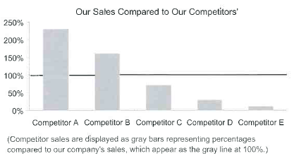
Measures of Ratio
Measures the relationship between a single pair of values
  Ratios can be expressed in 4 ways (Sentence, fraction, rate and percentage)
  Good use of ratios is to compare several individual values to a particular value to show how they differ. You can see the degree they differ. If you are not concerned with the actual value, percentages work better.

Slide 12
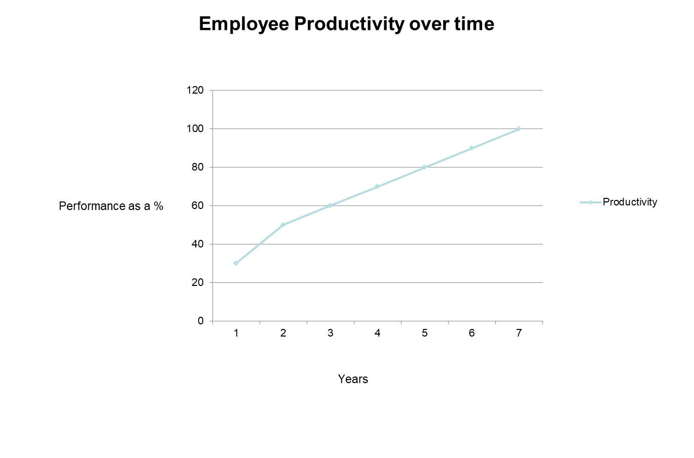
Correlation
Compares two paired sets of quantitative values to determine whether increases in one
correspond to either increases or decreases in the other
Example
Is there a correlation between the number of years an employee is doing their job versus their productivity?
What would the graph look like if both variables increased?

Slide 13
Measures of Correlation
Statistical measurement of the relationship, either positive or negative, between two variables.
Measure correlation and express it as a single value
  Does a correlation exist?
  If so, is it strong or weak?
  If so, is it negative or positive?
Example
  Two sets of values compared to see if there is a consistent relationship
    Class attendance vs GPA

Slide 14
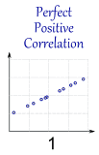
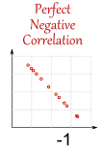
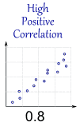
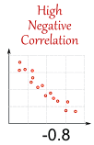
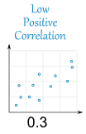
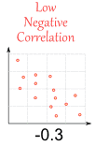

Measures of Correlation

Slide 15
Numbers that Summarize
Surely we don’t need a slide to discuss what the average is. OK, but give me a definition.
An average is a single number that represents the centre of an entire set of numbers
Four distinct ways to measure the centre of a set of numbers;
    Mean
    Median
    Mode
    Midrange
What is the advantage of using numbers like this?

Slide 16
Mean
This is what most of consider the average
  Sum of numbers divided by the number of numbers
We take every value into account. Sometimes this is what we want but sometimes working out the average in this manner can be misleading. What about the table below?
Quarter | Units Sold
Q1 | 500
Q2 | 400
Q3 | 350
Q4 | 350
Sum | 1,600
Count | 4
Mean (per Qtr) | 400
Employee | Position | Annual Salary
Employee A | Vice President | 475,000
Employee B | Manager | 165,000
Employee C | Manager | 165,000
Employee D | Developer | 52,000
Employee E | Developer | 50,000
Employee F | Analyst | 45,000
Employee G | Analyst | 43,000
Employee H | Intern | 28,000
Employee I | Intern | 27,000
 | Mean Salary | €125,556

Slide 17
Median
Median is not sensitive to extreme values
  Sort the values in order, find the value that falls in the middle
If you wanted to communicate the typical salary in a department, which would you use, Mean or Median?
Employee | Position | Annual Salary
Employee A | Vice President | 475,000
Employee B | Manager | 165,000
Employee C | Manager | 165,000
Employee D | Developer | 52,000
Employee E | Developer | 50,000
Employee F | Analyst | 45,000
Employee G | Analyst | 43,000
Employee H | Intern | 28,000
Employee I | Intern | 27,000
 | Mean Salary | €125,556
  Mean – want to take all values into account (less extreme values involved)

Slide 18
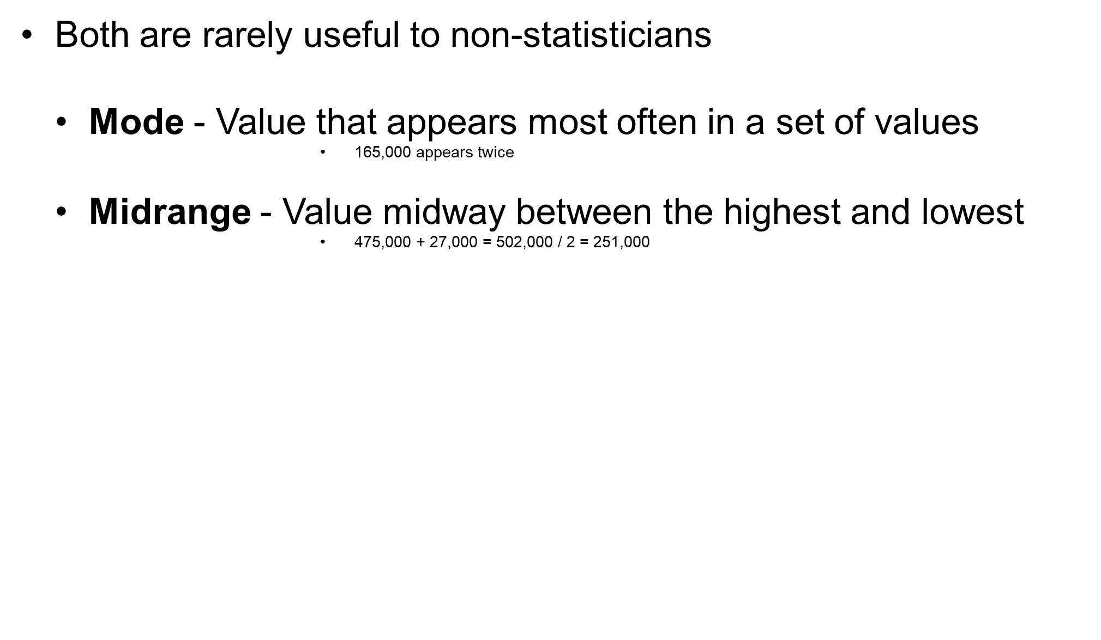
Mode and Midrange
Employee | Position | Annual Salary
Employee A | Vice President | 475,000
Employee B | Manager | 165,000
Employee C | Manager | 165,000
Employee D | Developer | 52,000
Employee E | Developer | 50,000
Employee F | Analyst | 45,000
Employee G | Analyst | 43,000
Employee H | Intern | 28,000
Employee I | Intern | 27,000
 | Mean Salary | €115,556

Slide 19
Measures of Variation
Useful to present how much values vary
    Example – what is the mean or median in each table below?
*Variation can be expressed using a single using
  Spread
  Standard Deviation
  *There are other methods too but we will just look at these since they are very useful
Region | Sales
Europe | 450,000
Asia | 350,000
America | 250,000
Africa | 150,000
Australia | 50,000
Region | Sales
Europe | 252,000
Asia | 251,000
America | 250,000
Africa | 249,000
Australia | 248,000
Median | €250,000
Mean | €250,000
Median | €250,000
Mean | €250,000

Slide 20
Measures of Variation example
Example – investigating customer complaints regarding the time it has taken for them to receive goods purchased.
Days to Ship
Order | Warehouse A | Warehouse B
1 | 3 | 1
2 | 3 | 1
3 | 3 | 1
4 | 4 | 3
5 | 4 | 3
6 | 4 | 4
7 | 5 | 5
8 | 5 | 5
9 | 5 | 5
10 | 5 | 6
11 | 5 | 7
12 | 5 | 10
Warehouse | Sum | Mean | Median
A | 51 | 4.25 | 4.5
B | 51 | 4.25 | 4.5

Slide 21
Measures of Variation example
Only when we focus on variation do we spot a problem
  A – provides consistent shipping from 3 – 5 days
  B – variation is less consistent and far greater
Days to Ship
Order | Warehouse A | Warehouse B
1 | 3 | 1
2 | 3 | 1
3 | 3 | 1
4 | 4 | 3
5 | 4 | 3
6 | 4 | 4
7 | 5 | 5
8 | 5 | 5
9 | 5 | 5
10 | 5 | 6
11 | 5 | 7
12 | 5 | 10

Slide 22
Spread
Simpler of the two methods
Subtract the lowest value from the highest value
Similar to Midrange
Affected by extreme values
Useful but Standard deviation offers greater accuracy
 | Warehouse A | Warehouse B
Range of days to ship | 2 | 9

Slide 23
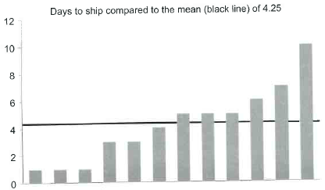
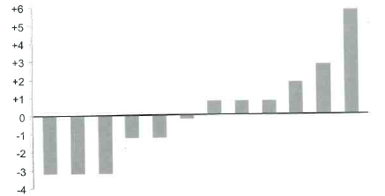
Standard Deviation
Measures variation in a set of values relative to the mean
Here is how we could visualise the number of days to ship against the mean

Slide 24
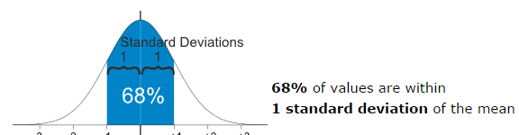
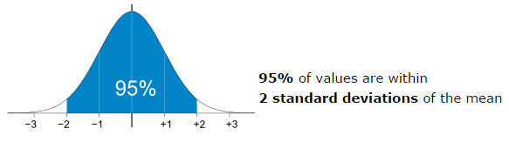
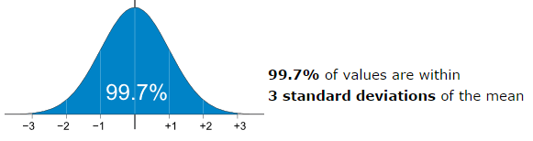
Standard Deviation
Several steps to calculate the standard deviation
  http://www.mathsisfun.com/data/standard-deviation-calculator.html
  Two methods depending on if you are using a sample set or the full set of values
Standard Deviation for Warehouse A = 0.86 and Warehouse B = 2.7 days
The bigger the standard, the broader the range of values, thus the greater difference in variation between them
Notes:
1,1,1,3,3,4,5,5,5,6,7,10

Slide 25
References
Stephen Few (2012). Show Me the Numbers. 2nd ed. USA: Analytics Press. Chapter 2 (Simple statistics)
Standard Deviation
  http://www.mathsisfun.com/data/standard-deviation-calculator.html

